Slide 1
Group 5 (SS6)
By:
Sim Xin Ni Clodia
Nicholas Chin Wei Lun
Tu Xia Yang
Vevek Selvam

Slide 2
Project 3
Dynamic Programming

Slide 3
Recursive Definition
P(C) = Max(p₀+P(C-w₀ ), p₁+P(C-w₁ ), … , p_{n-1}+P(C-w_{n-1} ))

Slide 4
b) Subproblem Graph
14
10
4
8
0
6
2

Slide 5
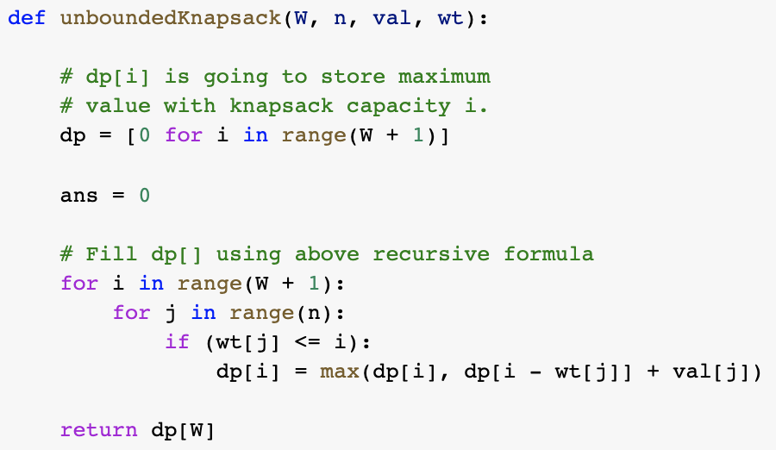
c) Dynamic Programming

Slide 6
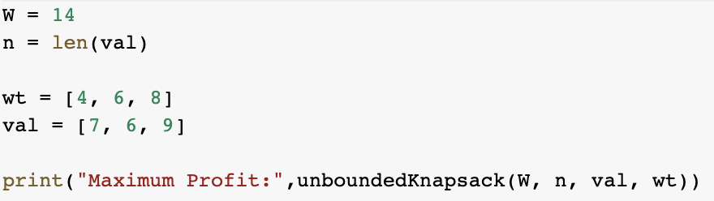

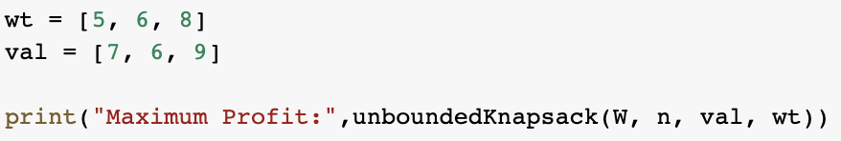

d) Results
a.
b.

